Slide 1
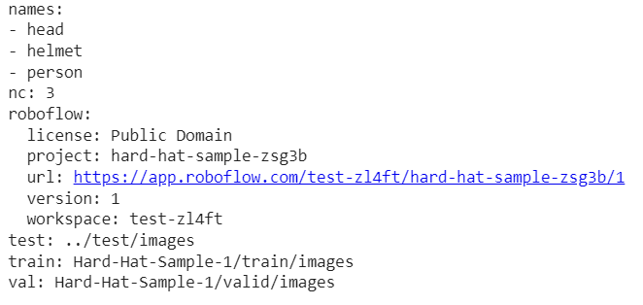
Class names
Number of classes
Directories

Slide 2
